Slide 1

Machine Learning and Data Mining
Lecture 1.1: k-Nearest Neighbors and Model Selection

Slide 2
What best summarizes your relationship with homework zero?
I’ve read over it and think I know what to do
I’ve read over it and am super lost
I haven’t really looked at it yet
I’ve been working through the problems

Slide 4
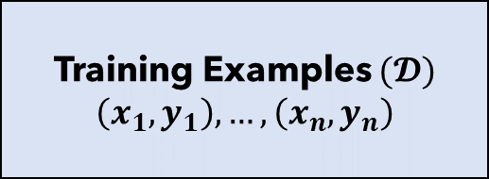

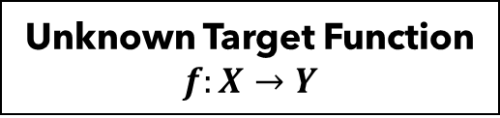


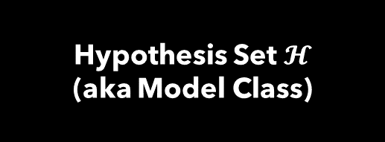
Machine Learning In a Nutshell
Unknown Target Function
$$f:X→Y$$
Loss Function
$$(𝓛)$$
Training Examples $(𝓓)$
$$\left(x_{1}, y_{1}\right), …, \left(x_{n}, y_{n}\right)$$
Learning Algorithm
$$(𝓐)$$
Selected Hypothesis
($g≈f)$
Hypothesis Set $𝓗$
(aka Model Class)
Observations of some phenomenon
Designed by us
Result of our learning

Slide 5






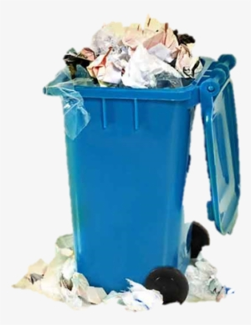
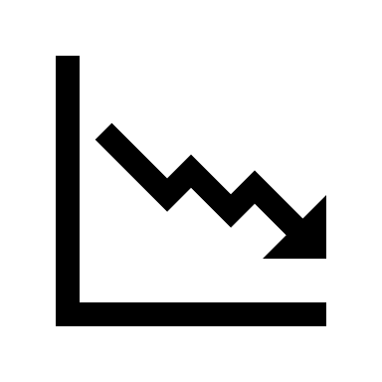
Machine Learning – A Cautionary Parable
Millow
But it worked so well on training data. The loss was so low!

Slide 6
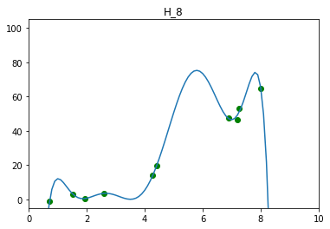
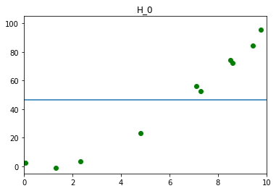
Overfitting, Underfitting, and Model Selection
Overfitting: Model performs well on training data, but poorly on held-out testing data.
Train
Test
Underfitting: Model performs poorly on training data. Likely also performs poorly on test data.
Train
Test
Model Selection: The exercise of finding a hypothesis space / model class that neither underfits or overfits. ← One of the reasons doing ML well is hard.

Slide 7




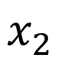
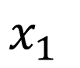
Intuition for your First Machine Learning Algorithm
$$x_{1}$$
$$x_{2}$$

Slide 8
Be able to answer:
How do I apply k-nearest neighbors to classification problems?
What is a decision boundary and how does it vary with k for k-nearest neighbor classifiers?
How can I use a weighting function in kNN?
What are some practical Issues for k-NN?
What is the curse of dimensionality?
How do I do model selection?
What is k-fold cross validation?

Slide 9
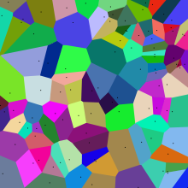
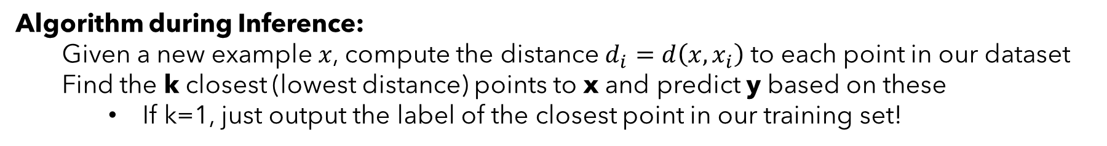
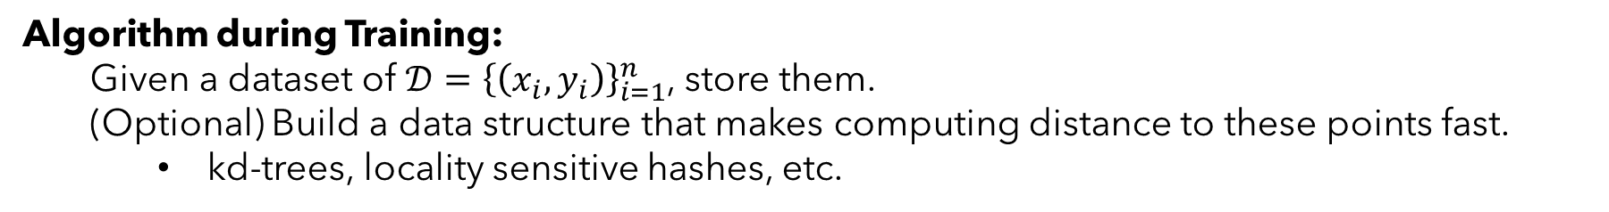
Nearest Neighbor Algorithm
Algorithm Name: k-Nearest Neighbors (kNN)
Type: Supervised Classifier / Regressor
Model Family: Instance-based Learning, Memory-based Learning, Exemplar Methods, Non-
Parametric methods
Algorithm during Training:
Given a dataset of $𝒟={\left\{\left(x_{i}, y_{i}\right)\right\}}_{i=1}^{n}$, store them.
(Optional) Build a data structure that makes computing distance to these points fast.
kd-trees, locality sensitive hashes, etc.
Algorithm during Inference:
Given a new example $x$, compute the distance $d_{i}=d\left(x, x_{i}\right)$ to each point in our dataset
Find the k closest (lowest distance) points to x and predict y based on these
If k=1, just output the label of the closest point in our training set!

Slide 10
Nearest Neighbor Algorithm
Four things define a k-nearest neighbor algorithm:
1) A distance metric (How do we tell which points are “close”?)
2) k (How many neighboring points do we look at?)
3) Output Function (Given a set of neighbors, how do we compute the output?)
4) Weighting Function (Do all k neighbors contribute equally?)

Slide 11
Nearest Neighbor Algorithm
1-nearest neighbor with Euclidean distance
1) A distance metric (How do we tell which points are “close”?)
Euclidean distance
2) k (How many neighboring points do we look at?)
1
3) Output Function (Given a set of neighbors, how do we compute the output?)
Output same as input
4) Weighting Function (Do all k neighbors contribute equally?)
Uniform

Slide 12
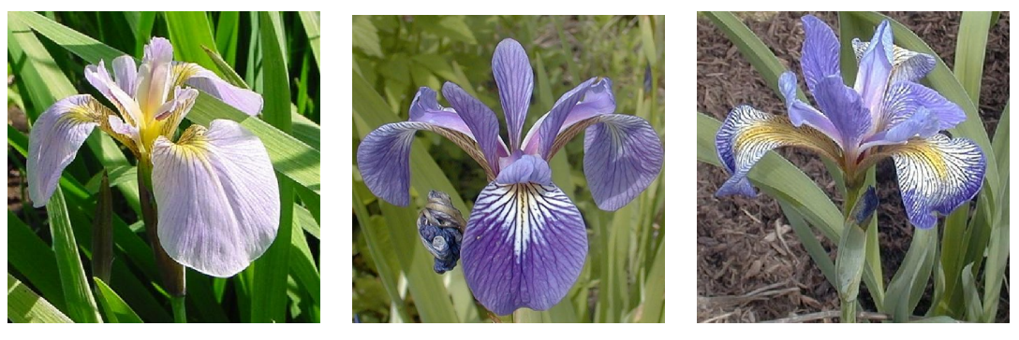
An Example: Iris Species Classification
Species of Iris (flower): setosa, versicolor, and virginica
Goal: Predict species {0,1,2} from some flower measurements
Slide adapted from Ameet Talwalker

Slide 13
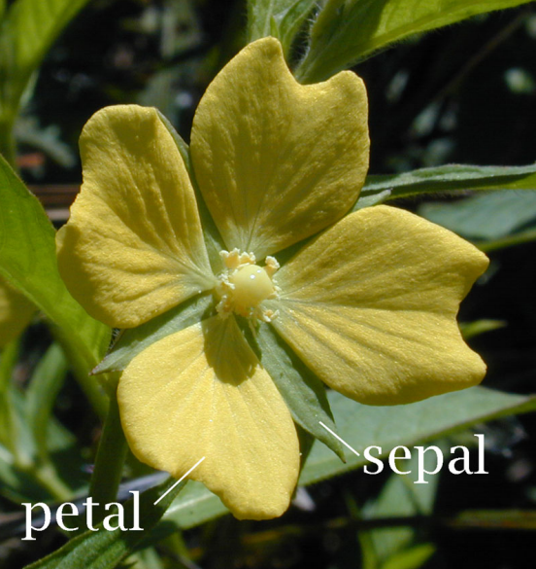
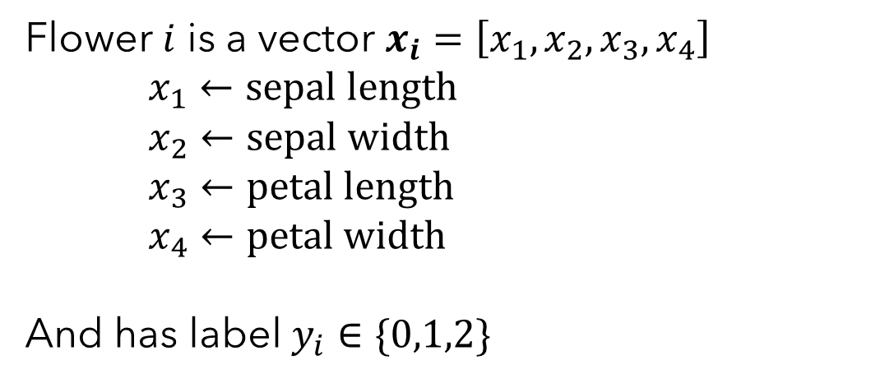
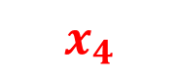
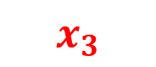
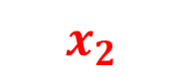
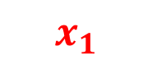
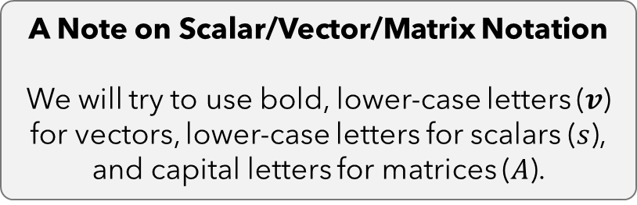
An Example: Iris Species Classification
Features: width and length of sepal and petal
Flower $i$ is a vector $x_{i}=\left[x_{1}, x_{2}, x_{3}, x_{4}\right]$
$x_{1}←sepal length$
$x_{2}←sepal width$
$x_{3}←petal length$
$x_{4}←petal width$
And has label $y_{i}∈\{0,1,2\}$
$$x_{4}$$
$$x_{3}$$
$$x_{1}$$
$$x_{2}$$
A Note on Scalar/Vector/Matrix Notation
We will try to use bold, lower-case letters ($v$) for vectors, lower-case letters for scalars ($s$), and capital letters for matrices ($A$).
Slide adapted from Ameet Talwalker

Slide 14
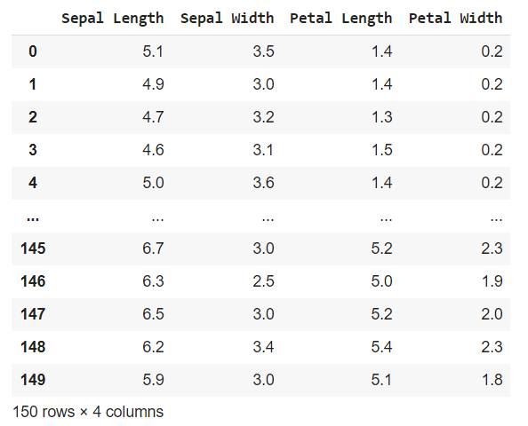
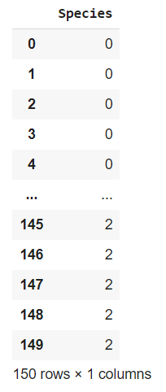
An Example: Iris Species Classification
Input / Features
Output / Label / Target
Slide adapted from Ameet Talwalker

Slide 15
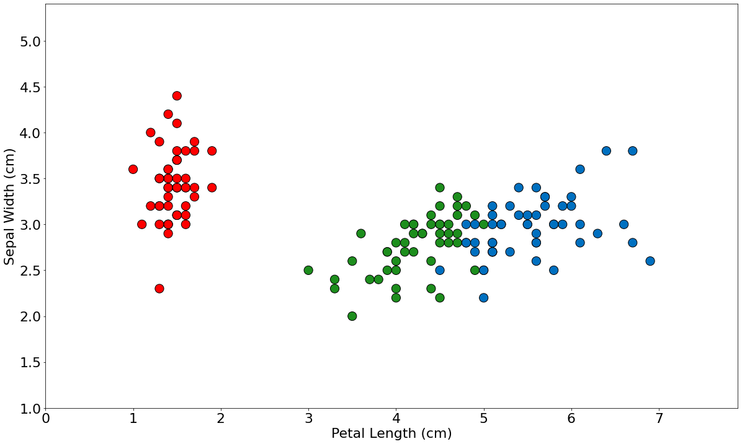
Formalizing k-Nearest Neighbors

Slide 16

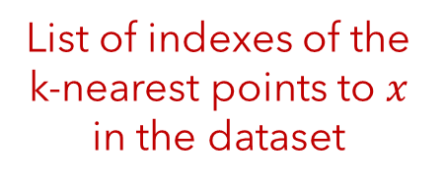
Formalizing k-Nearest Neighbors
Neighborhood: Given a dataset of $𝒟={\left\{\left(x_{i}, y_{i}\right)\right\}}_{i=1}^{n}$, let the set of k-nearest neighbors of some point $x$ be denoted as the neighborhood $N_{k}(x)$ such that
List of indexes of the k-nearest points to $x$ in the dataset
$$N_{k}\left(x\right)=[n_{1}, n_{2}, …, n_{k}]$$
Where $d\left(x, x_{n_{1}}\right)≤d\left(x, x_{n_{2}}\right)≤ …≤d\left(x, x_{n_{k}}\right)≤d\left(x, x_{j}\right)∀j∉N_{k}(x)$
And the neighbors are closer than any non-neighbor point
The list is ordered by distance.

Slide 17
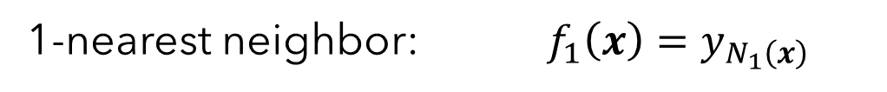
Formalizing k-Nearest Neighbors
Classification Rule: Given a dataset of $𝒟={\left\{\left(x_{i}, y_{i}\right)\right\}}_{i=1}^{n}$, let $f_{k}(x)$be the prediction of a k-nearest neighbor classifier on a point $x$ such that:
Just predict the same label as the closest point
1-nearest neighbor: $f_{1}\left(x\right)=y_{N_{1}\left(x\right)}$

Slide 18
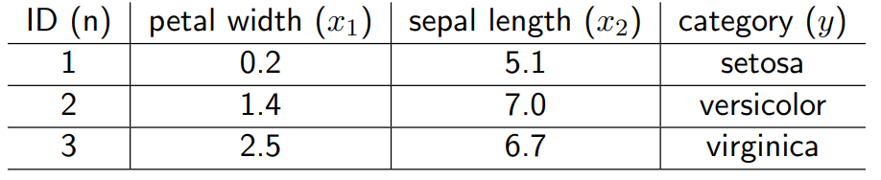
Training data
New flower x with petal width = 1.8 and sepal length = 6.4
Using Euclidean distance $d\left(x,z\right)=\sqrt{∑{\left(x_{i}−z_{i}\right)}^{2}}$, what would a 1-nearest neighbors classifier output for $x$?
Setosa
Versicolor
Virginica

Slide 19
An Example: Iris Species Classification
Training data
New flower x with petal width = 1.8 and sepal length = 6.4
$$d\left(x,x_{1}\right)=\sqrt{{\left(1.8−0.2\right)}^{2}+{\left(6.4−5.1\right)}^{2}}≈2.06$$
$$d\left(x,x_{2}\right)=\sqrt{{\left(1.8−1.4\right)}^{2}+{\left(6.4−7.0\right)}^{2}}≈0.72$$
Predict the new flower as versicolor
$$d\left(x,x_{3}\right)=\sqrt{{\left(1.8−2.5\right)}^{2}+{\left(6.4−6.7\right)}^{2}}≈0.76$$

Slide 20
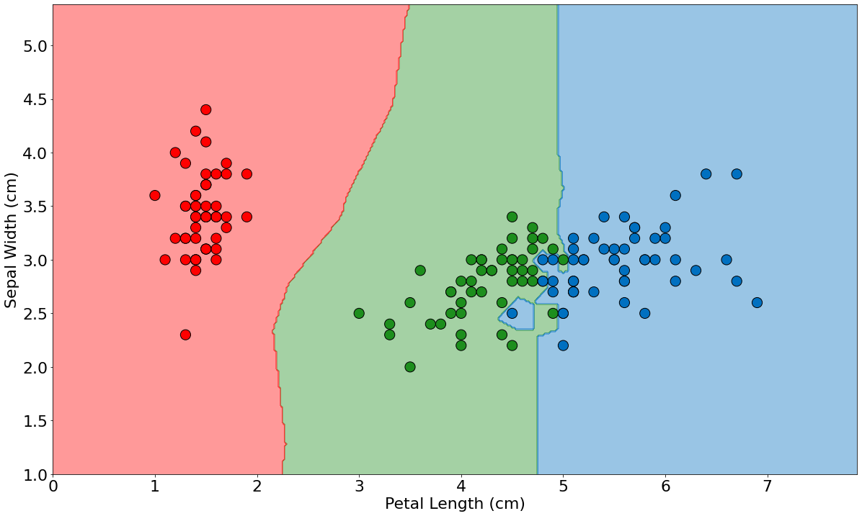
An Example: Iris Species Classification
Can check the classifier’s output at every point to make a figure like this
setosa, versicolor, and virginica
Call the lines that partition the space into class-similar regions decision boundaries

Slide 21
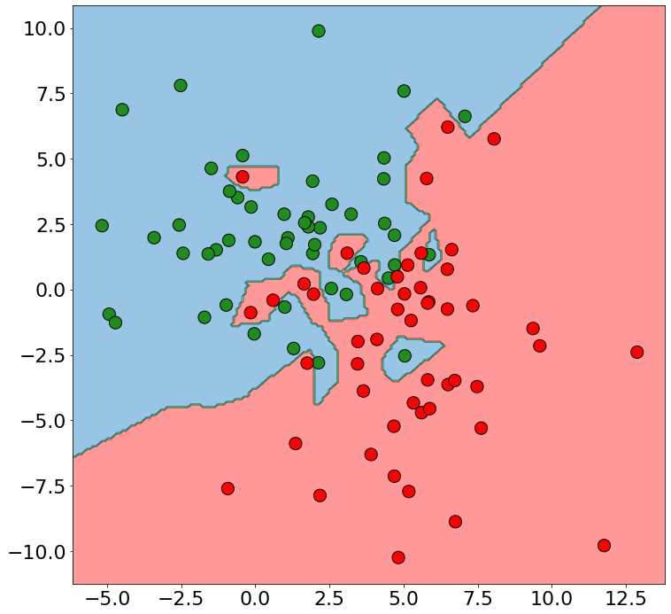
More on the Effect of k on Decision Boundaries
k=1
If your dataset has noise or many examples, these decision boundaries can become nasty!
Noisy training examples might lead to poor generalization to new data.
We can try to combat this by increasing the number of neighbors we examine.

Slide 22
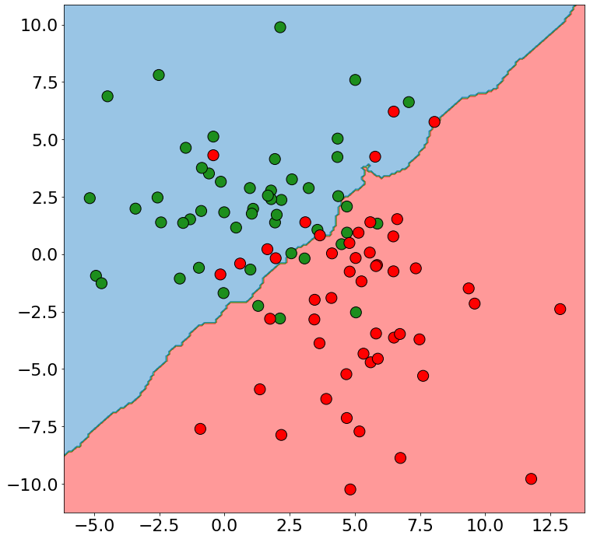
More on the Effect of k on Decision Boundaries
k=20
If your dataset has noise or many examples, these decision boundaries can become nasty!
Noisy training examples might lead to poor generalization to new data.
We can try to combat this by increasing the number of neighbors we examine.

Slide 23
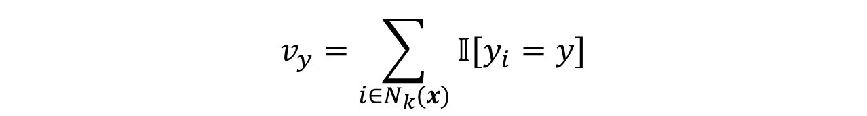
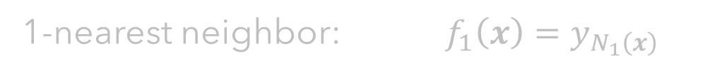
Formalizing k-Nearest Neighbors
Classification Rule: Given a dataset of $𝒟={\left\{\left(x_{i}, y_{i}\right)\right\}}_{i=1}^{n}$, let $f_{k}(x)$be the prediction of a k-nearest neighbor classifier on a point $x$ such that:
1-nearest neighbor: $f_{1}\left(x\right)=y_{N_{1}\left(x\right)}$
Predict whichever label most neighbors have
k-nearest neighbor: $f_{k}\left(x\right)=arg\max_{y∈Y}{v_{y}}$
$$v_{y}=\sum_{i∈N_{k}(x)}{𝕀[y_{i}=y]}$$
Tally votes for each label from each neighbor
Note: The indicator function $𝕀[condition]$ is 1 if condition is true, and 0 otherwise.

Slide 24
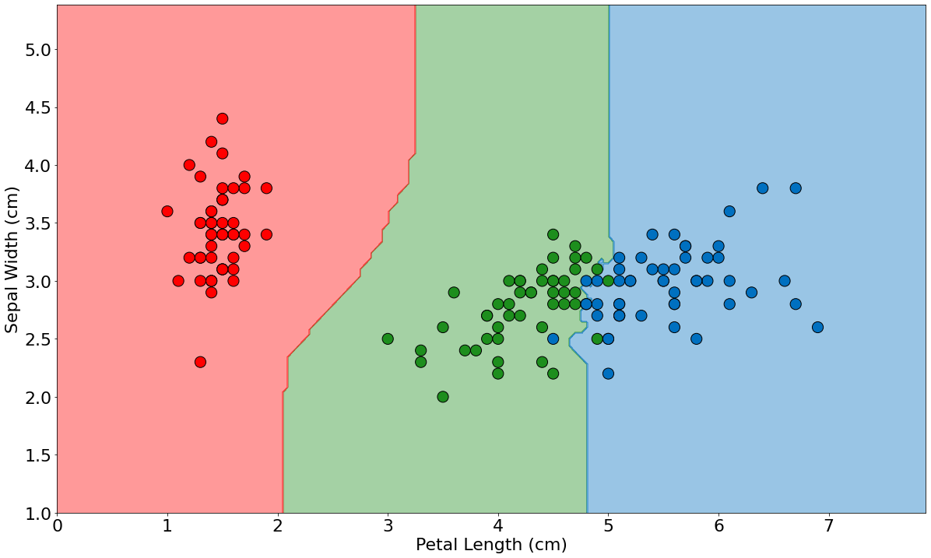
An Example: Iris Species Classification
Decisions made from a 5-nearest neighbor algorithm
setosa, versicolor, and virginica

Slide 25
How many training examples will be incorrectly classified by a 1-nearest neighbor classifier? (You can assume no duplicate points)
Unknowable – will depend on the dataset.
33% (or random chance) in a 3-way problem.
There will be zero errors on the training set.
No idea.

Slide 26
If k is set to n (the number of training examples), what will the model output for test points?
(Assume we count votes as before)
The majority class in the test set
Whatever class is nearby the test points
The majority class in the training set
No idea.

Slide 27
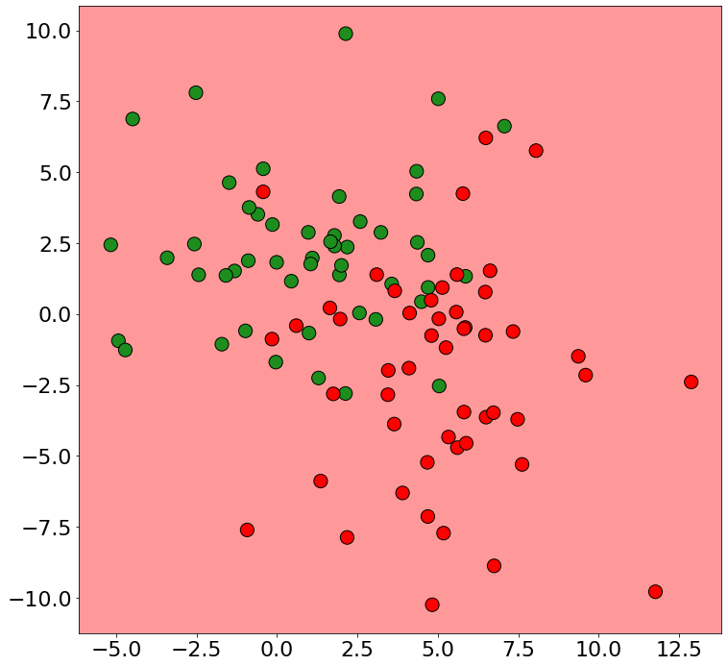
The Effect of Extreme k-values
k=1
k=n
At k=1, training error is zero because each point is its own nearest neighbor!
At k=n, every point is a neighbor so the majority class in the dataset is predicted everywhere.

Slide 28
Nearest Neighbor Algorithm
Four things define a k-nearest neighbor algorithm:
1) A distance metric (How do we tell which points are “close”?)
Euclidean
2) k (How many neighboring points do we look at?)
5
3) Output Function (Given a set of neighbors, how do we compute the output?)
Majority vote
4) Weighting Function (Do all k neighbors contribute equally?)
Uniform

Slide 29

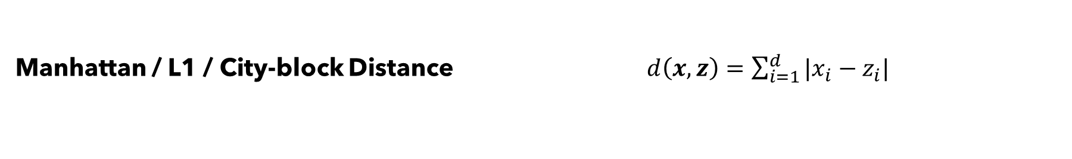
Various Distance Metrics
Euclidean / L2 / Straight-line Distance $d\left(x,z\right)=\sqrt{\sum_{i=1}^{d}{{\left(x_{i}−z_{i}\right)}^{2}}}$
Manhattan / L1 / City-block Distance $d\left(x,z\right)=\sum_{i=1}^{d}{|x_{i}−z_{i}|}$
Chebyshev / L-infinity / Maximum Distance $d\left(x,z\right)=\max_{i}{|x_{i}−z_{i}|}$
Minkowski Distance $d\left(x,z\right)={\left({\sum_{i=1}^{d}{\left|x_{i}−z_{i}\right|}}^{p}\right)}^{\frac{1}{p}}$

Slide 30
Various Distance Metrics
Minkowski Distance p=2
Euclidean / L2 / Straight-line Distance $d\left(x,z\right)=\sqrt{\sum_{i=1}^{d}{{\left(x_{i}−z_{i}\right)}^{2}}}$
Minkowski Distance p=1
Manhattan / L1 / City-block Distance $d\left(x,z\right)=\sum_{i=1}^{d}{|x_{i}−z_{i}|}$
Minkowski Distance p$→∞$
Chebyshev / L-infinity / Maximum Distance $d\left(x,z\right)=\max_{i}{|x_{i}−z_{i}|}$
Minkowski Distance $d\left(x,z\right)={\left({\sum_{i=1}^{d}{\left|x_{i}−z_{i}\right|}}^{p}\right)}^{\frac{1}{p}}$

Slide 31
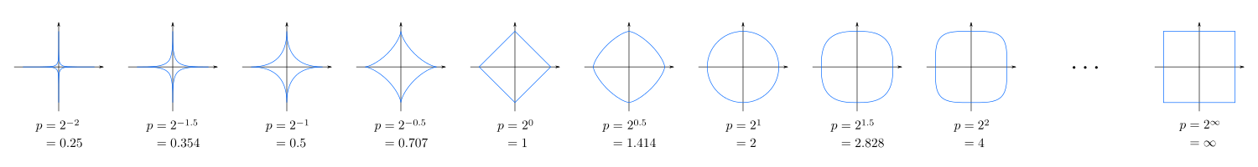
Various Distance Metrics
Blue line is points at distance 1 from 0,0
Minkowski Distance $d\left(x,z\right)={\left({\sum_{i=1}^{d}{\left|x_{i}−z_{i}\right|}}^{p}\right)}^{\frac{1}{p}}$

Slide 32
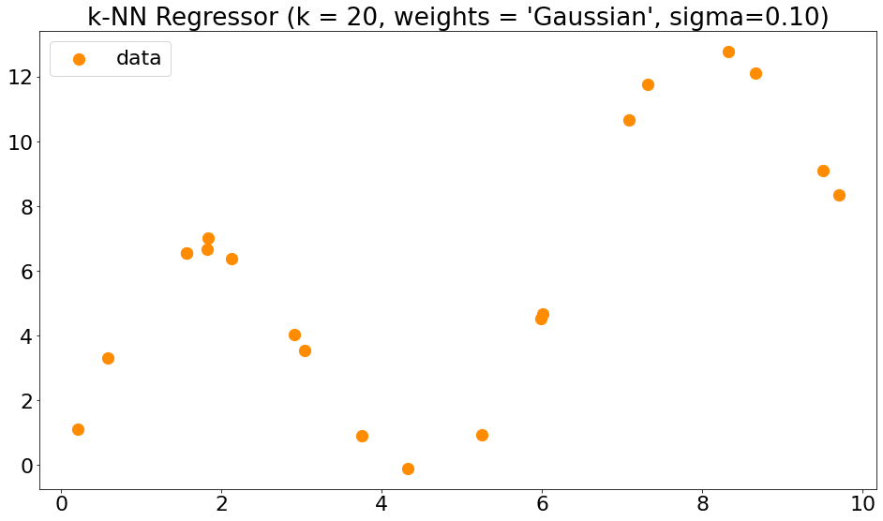
Formalizing k-Nearest Neighbors for Regression

Slide 33
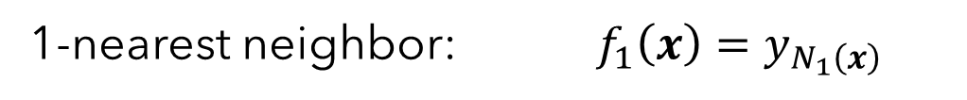
Formalizing k-Nearest Neighbors for Regression
Regression Rule: Given a dataset of $𝒟={\left\{\left(x_{i}, y_{i}\right)\right\}}_{i=1}^{n}$, let $f_{k}(x)$be the prediction of a k-nearest neighbor regressor on a point $x$ such that:
1-nearest neighbor: $f_{1}\left(x\right)=y_{N_{1}\left(x\right)}$
Predict average value of neighbors
k-nearest neighbor: $f_{k}\left(x\right)=\frac{1}{k}\sum_{i∈N_{k}(x)}{y_{i}}$

Slide 34
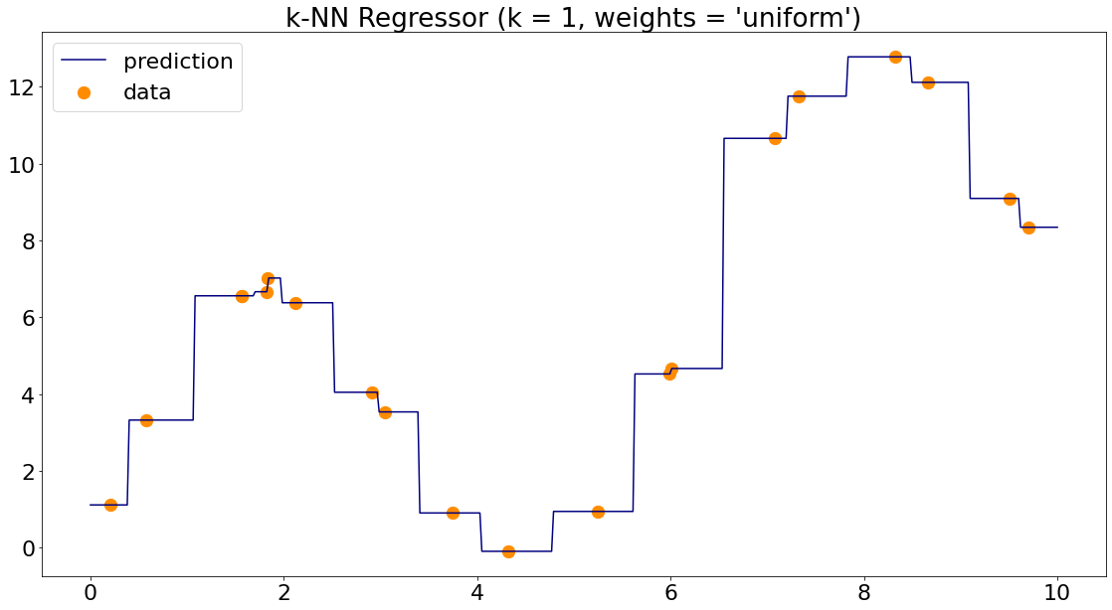
Formalizing k-Nearest Neighbors for Regression

Slide 35
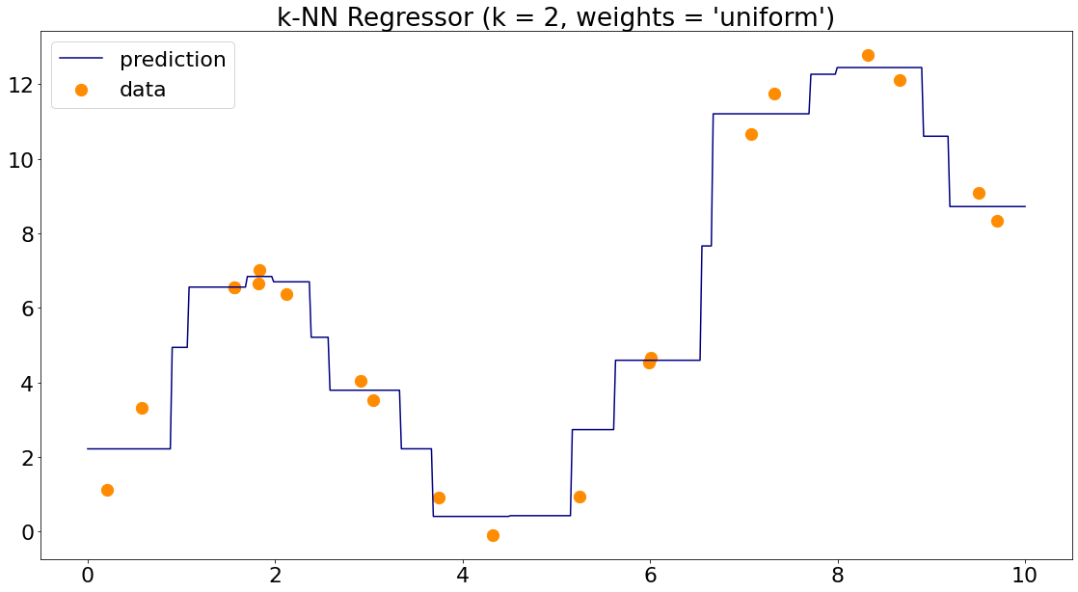
Formalizing k-Nearest Neighbors for Regression

Slide 36
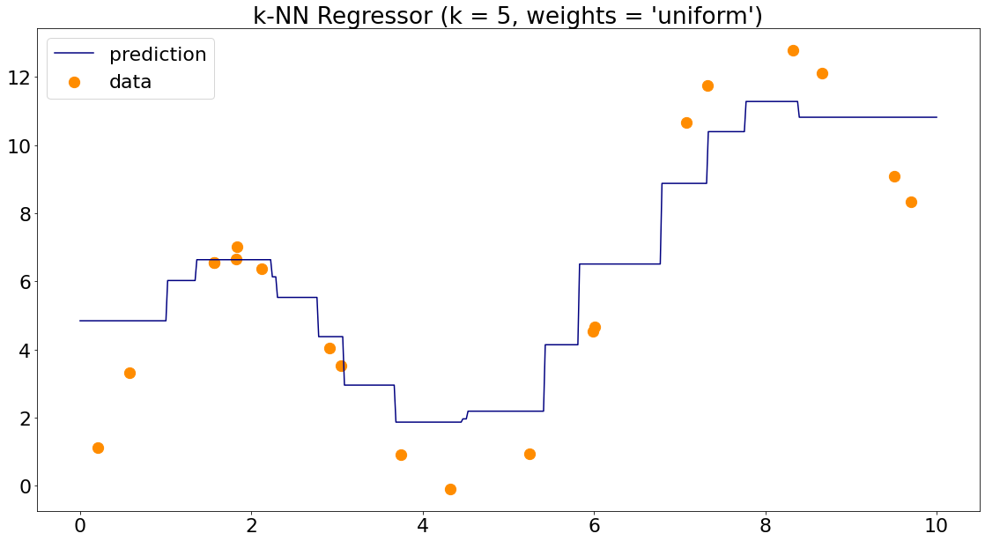
Formalizing k-Nearest Neighbors for Regression

Slide 37
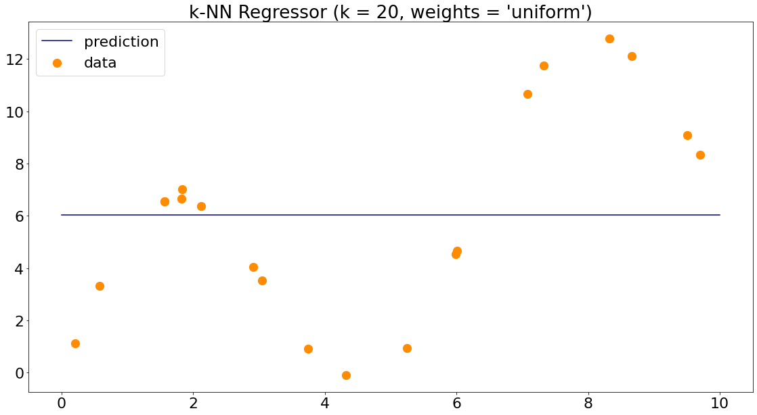
If k is set to n (the number of training examples), what will a k-NN regression model output for test points?
The average of the test set
An average of the nearest two points
The average of the training set
No idea.

Slide 38
Weighted k-Nearest Neighbor
Idea: Shouldn’t nearer points contribute more to the value at a new point?

Slide 39
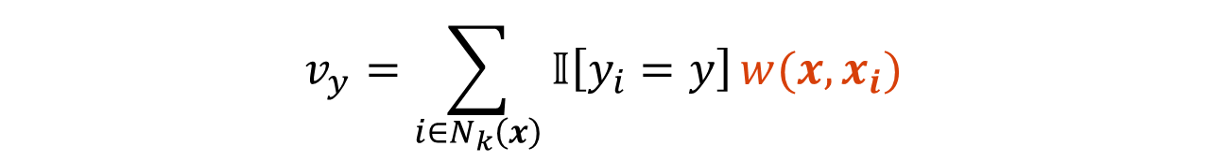
Weighted k-Nearest Neighbor
Predict weighted average value of neighbors
For Regression:
k-nearest neighbor: $f_{k}\left(x\right)=\frac{1}{k}\sum_{i∈N_{k}(x)}{y_{i}}$
weighted k-nearest neighbor: $f_{k}\left(x\right)=\frac{1}{\sum_{i∈N_{k}(x)}{w\left(x, x_{i}\right)}}\sum_{i∈N_{k}(x)}{w\left(x, x_{i}\right)y_{i}}$
For Classification:
Neighbors vote in proportion to their weight
weighted k-nearest neighbor: $f_{k}\left(x\right)=arg\max_{y∈Y}{v_{y}}$
$$v_{y}=\sum_{i∈N_{k}\left(x\right)}{𝕀\left[y_{i}=y\right]}w(x, x_{i})$$

Slide 40
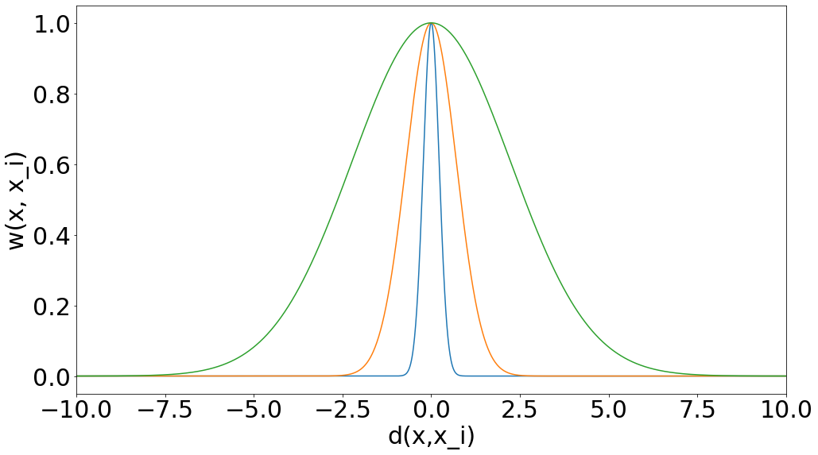
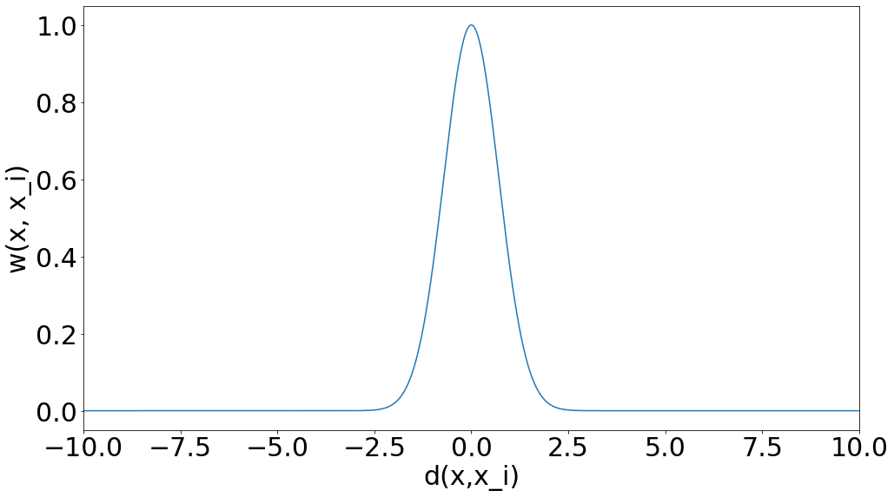
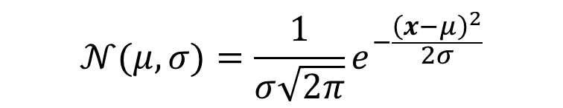
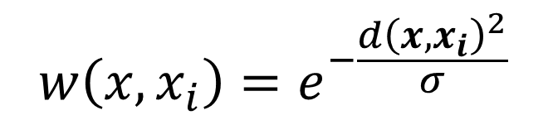
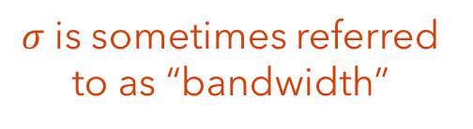
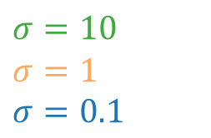
Weighted k-Nearest Neighbor
What makes a good weight function?
Gets small as distance from point gets large
One good candidate:
$$σ=10$$
$$σ=1$$
$$σ=0.1$$
$$w\left(x,x_{i}\right)=e^{−\frac{d{\left(x,x_{i}\right)}^{2}}{σ}}$$
$σ$is sometimes referred to as “bandwidth”
$$𝒩(μ, σ)=\frac{1}{σ\sqrt{2π}}e^{−\frac{{\left(x−μ\right)}^{2}}{2σ}}$$
Does these curves look familiar?
Gaussians my dear Watson. Gaussians!

Slide 41
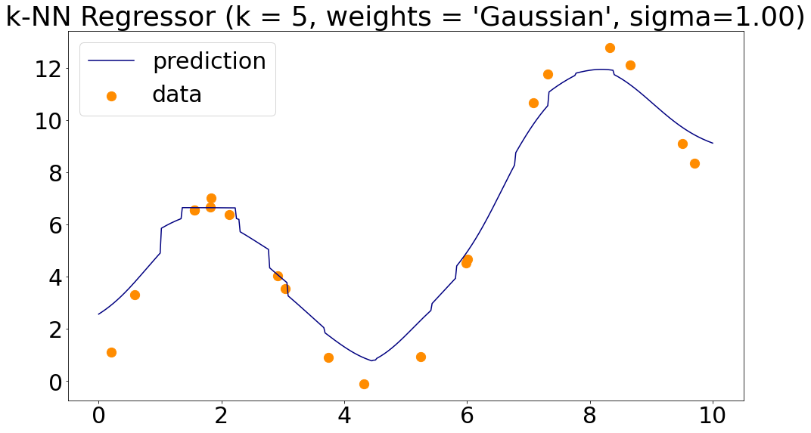
Weighted k-Nearest Neighbor
Weighting seems to smooth things out. Still a bit jagged on neighbor transitions.

Slide 42
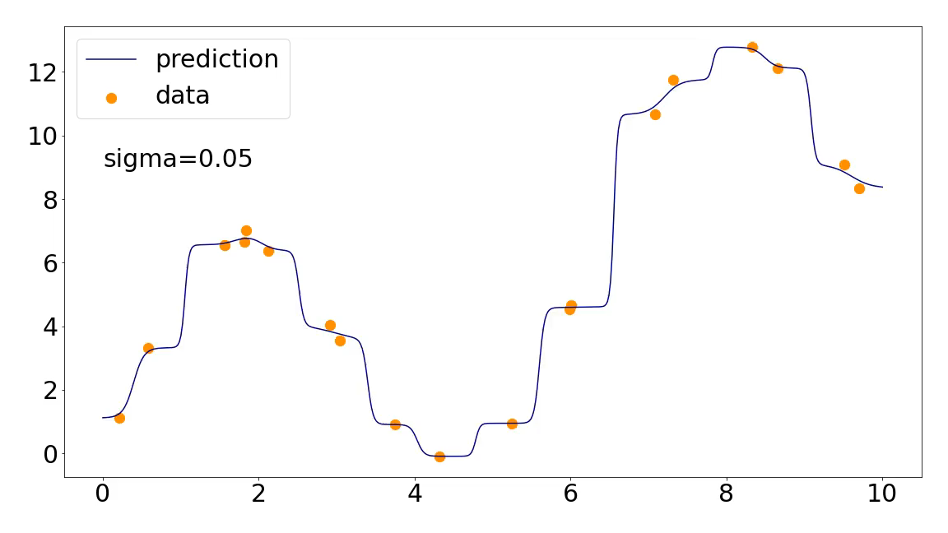
Weighted k-Nearest Neighbor
Interestingly, can now go k=n without collapsing if sigma is not large.

Slide 43



Weighted k-Nearest Neighbor
Can do the same thing with classification to smooth boundaries
k=10, unweighted
k=10, $σ$=10

Slide 44
Weighting is irrelevant for 1-NN models.
True
False

Slide 45
Be able to answer:
How do I apply k-nearest neighbors to classification problems?
What is a decision boundary and how does it vary with k for k-nearest neighbor classifiers?
How can I use a weighting function in kNN?
What are some practical Issues for k-NN?
What is the curse of dimensionality?
How do I do model selection?
What is k-fold cross validation?

Slide 46
Practical Issues with k-NN
Finding Nearest Neighbors Can Be Expensive Computationally
Suppose our training set contains n, d-dimensional points. For a new point, finding the nearest neighbors requires computing distance to all n points.
O(nd) for every test point! (Most distances require O(d) operations)
Plenty of work to speed this up with smart data structures to quickly find approximate nearest neighbors – most focus on partitioning space
Kd-trees, Ball-trees, Locality Sensitive Hash, ….
Have to Store All the Datapoints
For massive datasets, requires lots of memory
Remove “unimportant examples”

Slide 47

Practical Issues with k-NN
Relative Scale of Features Matters for Most Distance Measures
Supposer we want to build a model to predict a person’s shoe size using the person’s height (feet) and weight (lbs) to make the prediction.
P1: (6.1, 175) P2: (5.7, 168) New Point: (6.1’, 170)
$$d\left(NP, P1\right)=\sqrt{{\left(6.1−6.1\right)}^{2}+{\left(175−170\right)}^{2}}=5$$
$$d\left(NP, P2\right)=\sqrt{{\left(6.1−5.7\right)}^{2}+{\left(170−168\right)}^{2}}≈2.04$$
Because weight has a larger range of values, its difference dominates the distance calculation.
Features should be normalized to have the same range of values (e.g. [0,1]), otherwise features with larger ranges will have bigger impact on the distance.

Slide 48


Practical Issues with k-NN
Relative Scale of Features Matters for Most Distance Measures
k=5, unwieghted

Slide 49


Practical Issues with k-NN
Relative Scale of Features Matters for Most Distance Measures
k=50, unwieghted
k=50, same feature scale

Slide 50
Practical Issues with k-NN
Irrelevant Features Also Contribute to Distance
Suppose we have other details about the people than their height and weight – things like GPA, number of shoes owned, zip code, etc. People have the urge to use every bit of data they find!
Should we include these?
Probably not. For k-NN to work, we want “nearness” in space to imply nearness in output. Adding a bunch of irrelevant attributes will make our distance less meaningful.
Beyond this, adding more attributes increased the dimensionality of our space, incurring the...
curse of dimensionality

Slide 51

The Curse of Dimensionality
High dimensional spaces can be really really unintuitive.
Distance doesn’t behave the way we think about it in 1/2/3 dimensions. Further, cost of computing distances scales with dimensionality and the same amount of data fills a smaller fraction of space.
Lots of reasons k-nearest neighbors seems like it shouldn’t work in high dimensions.

Slide 52



The Curse of Dimensionality
Example 1: Consider a circle of radius 1 and a thin shell of width $ε$ beneath its surface.
What percentage of the area is within the thin shell?
$$Area of Whole Circle=2πr^{2}=2π$$
$$Area of Shell=2πr^{2} −2π{\left(r−ε\right)}^{2}=2π−2π{\left(1−ε\right)}^{2}$$
$$1$$
$$\frac{Area of Shell}{Area of Circle}=\frac{2π −2π{\left(1−ε\right)}^{2}}{2π}=1−{\left(1−ε\right)}^{2}$$
$$1−ε$$

Slide 53


The Curse of Dimensionality
Example 1: Consider a circle of radius 1 and a thin shell of width $ε$ beneath its surface.
What percentage of the area is within the thin shell?
$$1$$
$$1−ε$$
$$\frac{Area of Shell}{Area of Circle}=1−{\left(1−ε\right)}^{2}$$

Slide 54










The Curse of Dimensionality
Example 1: Consider a d-ball of radius 1 and a thin shell of width $ε$ beneath its surface.
d=1
d=2
d=3
$$x_{1}^{2}=1$$
$$x_{1}^{2}+x_{2}^{2}=1$$
$$x_{1}^{2}+x_{2}^{2}+x_{3}^{2}=1$$
$$Volume of Whole=2r$$
$$Volume of Whole=πr^{2}$$
$$Volume of Whole=\frac{4}{3}πr^{3}$$
$$c_{1}r$$
$$c_{2}r^{2}$$
$$c_{3}r^{3}$$
More generally, seems like the pattern for volume of a d-ball is $c_{d}r^{d}$

Slide 55

The Curse of Dimensionality
Example 1: Consider a d-ball of radius 1 and a thin shell of width $ε$ beneath its surface.
d=1
d=2
d=3
$$x_{1}^{2}=1$$
$$x_{1}^{2}+x_{2}^{2}=1$$
$$x_{1}^{2}+x_{2}^{2}+x_{3}^{2}=1$$
More generally, seems like the pattern for volume of a d-ball is $c_{d}r^{d}$
$$\frac{Area of Shell}{Area of Circle}=\frac{c_{d} −c_{d}{\left(1−ε\right)}^{d}}{c_{d}}=1−{\left(1−ε\right)}^{d}$$

Slide 56


The Curse of Dimensionality
Example 1: Consider a d-ball of radius 1 and a thin shell of width $ε$ around that circle.
$$\frac{Area of Shell}{Area of Circle}=1−{\left(1−ε\right)}^{d}$$ $$⟹\frac{Area of Shell}{Area of Circle}→1 as d→∞$$
d=100
Conclusion: In higher dimensions, nearly all the volume lies in a super thin outer shell which is equidistant to the center.
If training data is uniformly distributed, we have a problem! Everything would be about the same distance away ☹
d=2

Slide 57


The Curse of Dimensionality
Example 2: Too abstract? Don’t trust me? Okay. Fair enough. Let’s run a simulation.
For d in [1,2,3,…,8,9,10,20,30,40,…,500]
Generate 100 points in ${\left[0,1\right]}^{d}$ uniformly
Compute all pair-wise distances
Plot a histogram of normalized distances
Conclusion: Distances between random points tend to be about the same in high dimensions relative to how big they could be.

Slide 58


The Curse of Dimensionality
If everything is equally far away, how on earth can k-nearest neighbors work?
Real data may not be uniformly distributed through the space, but instead live on a lower dimensional subspace
E.g. not every 256x256x3 matrix is a natural image
May still need to perform dimensionality reduction or choose/learn an appropriate distance function though

Slide 59
Be able to answer:
How do I apply k-nearest neighbors to classification problems?
What is a decision boundary and how does it vary with k for k-nearest neighbor classifiers?
How can I use a weighting function in kNN?
What are some practical Issues for k-NN?
What is the curse of dimensionality?
How do I do model selection?
What is k-fold cross validation?

Slide 60
Hyperparameters of k-Nearest Neighbors
Seems like we’ve acquired a bunch of knobs we can turn and choices we can make when defining our “simple” model…. how do we choose them?
1) A distance metric (How do we tell which points are “close”?)
Euclidean / Manhattan / Some exotic Minkowski distance?
2) k (How many neighboring points do we look at?)
1? 5? 10? n/4?
3) Output Function (Given a set of neighbors, how do we compute the output?)
To weight or not to weight?
4) Weighting Function (Do all k neighbors contribute equally?)
If weighting, what function? $\frac{1}{d\left(x,x_{i}\right)}$? $e^{−\frac{d{\left(x,x_{i}\right)}^{2}}{σ}}$? If so, what bandwidth/variance?

Slide 61

Model Selection
Hyperparameters

Slide 62
I should choose hyperparameters by
Checking performance on the training set
Checking performance on the test set
By manually looking at the fit
None of these sound right

Slide 63




How to choose hyperparameters? k as an example.
Training performance doesn’t tell us much.
Peaks at k=1 and drops at n as expected.

Slide 64
Overfitting, Underfitting, and Model Selection
Overfitting: Model performs well on training data, but poorly on held-out testing data.
Train
Test
Underfitting: Model performs poorly on training data. Likely also performs poorly on test data.
Train
Test
Model Selection: The exercise of finding a hypothesis space / model class that neither underfits or overfits. ← One of the reasons doing ML well is hard.

Slide 65
Model Selection – The Validation Set
The training set won’t help us avoid overfitting and the test set is off-limits.
Get a third set of datapoints and call it the validation set. May “create” this set of datapoints by randomly splitting off some fraction of the training set.
Training Data
Test Data
(Do not touch!)
Training Data
Validation Data
Test Data
(Do not touch!)
Model Selection Procedure:
Pick a set of hyperparameters
Train your model on the training set
Evaluate on the validation set
If happy, stop. Otherwise loop back to 1.
At very end when you’ve picked the best hyperparameters you can, then you evaluate on test and report results. No more tuning at this point.

Slide 66
Model Selection – Size of Validation Set
More data ➔ Better estimate of performance
If we only keep one point in our validation set, should we trust the validation error as a reliable estimate of our model’s performance?
Training Data
Validation Data
Test Data
(Do not touch!)
Probably not. The larger the validation set, the more reliable our model selection choices will be in terms of generalization to the test set.
Problem: When the dataset is small, we might not be able to get a big enough validation set to make a good model selection choices without loosing too much training data.

Slide 67
Model Selection – K-fold Cross Validation
Idea: Make many validation sets and evaluate model choices by average performance over them.
K-Fold Cross Validation Procedure
Randomly split the training set into K equally-sized subsets
Subsets should have similar distributions
For each subset i:
Combine all subsets except i and train the model on this.
Evaluate the model on subset i.
Compute average performance over these K train/evaluation runs.
Training Data
Subset 1
Subset 2
Subset 3
Subset 4
Subset 1
Subset 2
Subset 3
Subset 4
Subset 1
Subset 2
Subset 3
Subset 4
Subset 1
Subset 2
Subset 3
Subset 4
Example: 4-fold cross validation

Slide 68

Model Selection – K-fold Cross Validation
Idea: Make many validation sets and evaluate model choices by average performance over them.
Training Data
Subset 1
Subset 2
Subset 3
Subset 4
Train on subsets 2,3,4. Test on subset 1 → $perf_{1}$
Subset 1
Subset 2
Subset 3
Subset 4
Train on subsets 1,3,4. Test on subset 2 → $perf_{2}$
Subset 1
Subset 2
Subset 3
Subset 4
Train on subsets 1,2,4. Test on subset 3 → $perf_{3}$
Subset 1
Subset 2
Subset 3
Subset 4
Train on subsets 1,2,3. Test on subset 4 → $perf_{4}$
Example: 4-fold cross validation
Estimated validation performance is $\frac{1}{4}(\sum_{i}{perf_{i})}$

Slide 69
Model Selection – K-fold Cross Validation
Model Selection Procedure:
Pick a set of hyperparameters
Train your model on the training set
Evaluate on the validation set
If happy, stop. Otherwise loop back to 1.
At very end when you’ve picked the best hyperparameters you can, then you evaluate on test and report results. No more tuning at this point.
Model Selection Procedure with K-Fold Cross Validation:
Pick a set of hyperparameters
Train your model on the training set
Perform K-Fold Cross Validation to estimate performance
If happy, stop. Otherwise loop back to 1.
At very end when you’ve picked the best hyperparameters you can, then you evaluate on test and report results. No more tuning at this point.

Slide 70
Model Selection – Leave-One-Out Cross Validation
What if K = n? Then we treat only one example as validation at a time. Call it Leave-One-Out.
Same approach as before, but we are going to have to train a LOT of models. May be prohibitively expensive for large, complicated, slow models.
k-NN: LOO cross validation is super easy in k-NN and other “lazy” learners
Simply classify each training point but don’t let it select itself as a nearest neighbor.
…
Example: Leave-One-Out Cross Validation with 1-nn

Slide 71
What is the leave-one-out cross validation accuracy for a 1-nearest neighbor model on this dataset:
5/6th
2/6th
3/6th
1/6th

Slide 72
Example Leave-One-Out Cross Validation
Accuracy: 0
Accuracy: 0
Accuracy: 1
3
Accuracy: 0
Accuracy: 0
Accuracy: 0
Leave-One-Out Cross Validation Accuracy Estimate: 1/6 or $≈$16.6%

Slide 73
Final Words on k-Nearest Neighbors
KNN is what we call lazy learning (vs. eager learning)
Lazy: learning only occur when you see the test example
Eager: learn a model before you see the test example, training examples can be thrown away after learning
Advantages:
Conceptually simple, easy to understand and explain
Very flexible decision boundaries
Disadvantages:
It can be hard to find a good distance measure – Irrelevant features and noise can be very detrimental
Typically, can not handle more than a few dozen attributes unless a good distance measure can be learned
Computational cost: requires significant computation and memory

Slide 74
Inefficient-but-easy-to-understand Psuedocode for k-NN Classification (unweighted)
Lots of the compute happens here. Can speed this up with broadcasted matrix operations in numpy.
getNeighbors(X,Y,x,k):
for each example x_{i} in X:
dists[i] = d(x, X_{i}) // compute distance to each data point
nearestK = argsort(dists)[:k] // ascending order sort, return indexes
return nearestK
Can find smallest k much more efficiently than the O(nlogn) need to sort all the distance.
kNNClassify(X,Y,x,k):
nearestK = getNeighbors(D,x,k) // find the k-nearest neighbors
output = mode([Y_{i} for i in nearestK]) // output whatever label is the majority
return output

Slide 75
Final Words on Model Selection
Model selection is typically done by holding out some portion of the labeled data to be used for selecting the best model
If there is large amounts of labeled data, using a single hold-out set for validation might be sufficient
E.g., NLP community often use fixed train/validation/testing split for replicability of the results
K-fold Cross-validation allows every training example to be considered while making the model selection choices
The larger the 𝐾, the more computationally intensive but more robust model selection decision

Slide 76
Next time
Next Time: We’ll move on into statistical learning with maximum likelihood estimation! Probability time!

